Slide 1
MGMT 6055 Project Scope & requirements
Lawrence Kinlin School of Business
Module 12
Notes:
Content for slides in this PPT file is drawn significantly from PMBOK, 6th edition, published by PMI (required text for this course)

Slide 2
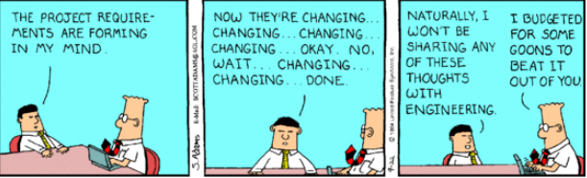
Learning Objectives
Validate scope
Scope creep
Notes:
Image Source: https://www.google.com/url?sa=i&rct=j&q=&esrc=s&source=images&cd=&cad=rja&uact=8&ved=2ahUKEwiggsPjhbbaAhVr0YMKHS_pDyEQjRx6BAgAEAU&url=http%3A%2F%2Fwww.trianglemarketingclub.com%2Fmaking-project-management-work%2Fdilbert-scope-creep%2F&psig=AOvVaw2RpULQXOSFAvWjnDGEa1Uc&ust=1523667462394880

Slide 3
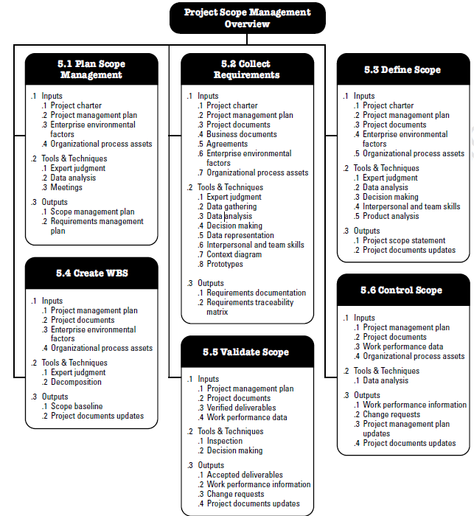
SIX scope-related processes (activities) are described in the PMBOK 6th ed. text
Source: PMBOK (6th ed), pg. 130

Slide 4
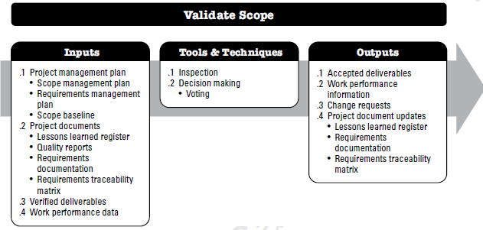
Validate Scope
The process of formalizing acceptance of the completed project deliverables. This includes:
Reviewing deliverables with the customer
Acceptance of the deliverables
Notes:
Source: PMBOK 6th ed. (PMI), p. 163, Figure 5-15

Slide 5
Validate Scope - Inputs
Project Management Plan
Scope Management plan
Requirements Management plan
Scope baseline
Project documents
Lessons learned register
Quality reports
Requirements documentation (BRD)
Requirements traceability matrix
Verified deliverables
Work performance data (E.g., Output data on tests for defects)

Slide 6
Validate Scope – Tools and Techniques
Inspection – comparing deliverables against requirements documentation
Reviews
Audits
Walkthroughs
Decision-making techniques (voting)

Slide 7
Recall from earlier this term: Group Decision-Making Techniques
We saw this tool/technique earlier in this course, in the “Collect Requirements” process
This technique is undertaken by the stakeholders and the project team
Includes unanimity, majority, plurality
Unanimity: everyone agrees
Majority: more than 50% of the participants agree
Plurality: the option with the most votes is selected (see next slide)

Slide 8
Recall from earlier this term: Group Decision-Making Techniques
Example of group decision-making that uses plurality…
Three alternative options are being considered by 20 stakeholders
Option A: 25% of the stakeholder participants (5 people) prefer this option
Option B: 40% of the stakeholder participants (8 people) prefer this option
Option C: 35% of the stakeholder participants (7 people) prefer this option
Option B is selected because it received the most votes… even though less than half of the stakeholders preferred this option

Slide 9
Validate Scope - Outputs
Accepted deliverables
Accepted by customer/sponsor
Work performance information
Resulting from analysis of work performance data
Change requests
If a deviation has been identified and a ‘fix’ would require a change to scope, cost, or schedule (more on this, later this term)
Project documents updates
If inspection of deliverables reveals a change that needs to be made to the project documents (e.g., traceability matrix, BRD, lessons learned register)

Slide 10
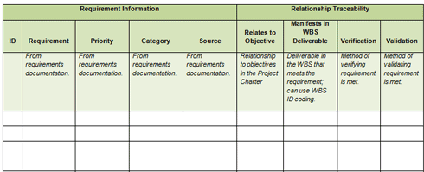

Validate Scope – Outputs (example)
Do you remember the difference between “Verify” and “Validate” scope?
Notes:
Source: https://ca.images.search.yahoo.com/images/view;_ylt=Az_6xdeR4DxWTD8AiJg.7olQ;_ylu=X3oDMTIzYmdnaXJxBHNlYwNzcgRzbGsDaW1nBG9pZAMwMGRjMjNiNTQzYmQ3ZmYzN2VkZTQ4YzA5MzgyYzFjNQRncG9zAzM5BGl0A2Jpbmc-?.origin=&back=https%3A%2F%2Fca.images.search.yahoo.com%2Fyhs%2Fsearch%3Fp%3Dverify%2Bscope%26type%3Drogers_pc_homerun_portal%26fr%3Dyfp-t-715%26fr2%3Dpiv-web%26hsimp%3Dyhs-rogers_001%26hspart%3Drogers%26tab%3Dorganic%26ri%3D39&w=504&h=351&imgurl=pmofficetemplates.com%2Fimages%2Fforpretty%2Frequirement-treacibility-matrixbig.png&rurl=http%3A%2F%2Fpmofficetemplates.com%2Fverify_scope.html&size=15.3KB&name=%3Cb%3EVerify+Scope%3C%2Fb%3E+Templates+|+Project+Management+Templates+|+PM+Template+...&p=verify+scope&oid=00dc23b543bd7ff37ede48c09382c1c5&fr2=piv-web&fr=yfp-t-715&tt=%3Cb%3EVerify+Scope%3C%2Fb%3E+Templates+|+Project+Management+Templates+|+PM+Template+...&b=0&ni=21&no=39&ts=&tab=organic&sigr=11e50ok76&sigb=158200fd0&sigi=12dph6ofc&sigt=12ebvpdpd&sign=12ebvpdpd&.crumb=f6hrMP4.khJ&fr=yfp-t-715&fr2=piv-web&hsimp=yhs-rogers_001&hspart=rogers&type=rogers_pc_homerun_portal

Slide 11
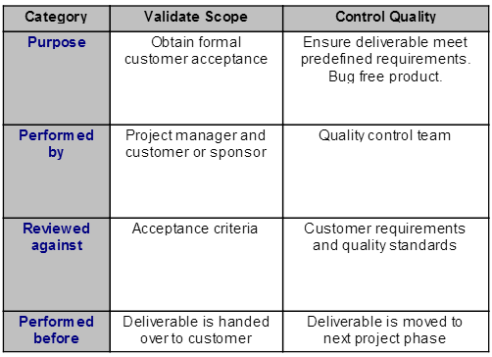
Validate Scope is NOT Quality Control!
FYI: not on the final exam
Validate Scope is part of the Scope Management knowledge area. Control Quality is part of the Quality Management knowledge area.
Notes:
Source: http://www.newinpm.com/Chapter-8-Project-Quality-Management/validate-scope-vs-quality-control.html

Slide 12
Scope Creep
The tendency for the project scope to expand over time
(Uncontrolled) change in requirements, specifications, priorities, external pressures
Scope creep can be reduced by having a well written scope statement

Slide 13
Scope Creep Activity
Watch the following (10 min) video about scope creep and the ‘Bradley Armoured Personnel Carrier’: https://www.youtube.com/watch?v=aXQ2lO3ieBA
Original (approved) scope:
A lightly armoured vehicle designed to carry troops swiftly, efficiently, and safely to a combat zone
Carries 11 personnel plus a driver
Includes a 20mm cannon for defensive firepower/flexibility
Cost is $1.5 million USD
As you’re watching, answer the following questions:
What design elements changed, and what were the purposes of each change?
WHY did the scope progressively “creep”?
What could the project manager have done to prevent this situation from happening?
Notes:
Group project

Slide 14
Controlling Scope Creep
Be vigilant from the beginning
Know when to say “yes” or “no” - and be prepared to say “no” (firmly but diplomatically!)
Utilize effective change management procedures (week 14)
Document change requests and reasons for them
Estimate the impact on cost and schedule
Make approvals formal
Understand your client’s vision
Understand progress requirements
Guard against “gold plating” (where team members over-deliver)
Consider closing the phase/project or setting aside proposed changes for a separate project
Understand how much creep you’re willing to allow/absorb and what you will make the customer pay for
Have a clear project schedule and budget with milestones
Verify the scope baseline with stakeholders
Notes:
Sources:
http://www.techrepublic.com/article/seven-steps-for-avoiding-scope-creep/
http://www.projectmanager.com/5-ways-to-avoid-scope-creep.php
http://www.clarityconsultants.com/wp-content/uploads/2012/09/How-to-prevent-or-minimize-scope-creep.pdf
http://www.project-skills.com/7-proven-ways-to-prevent-project-scope-creep.html

Slide 15
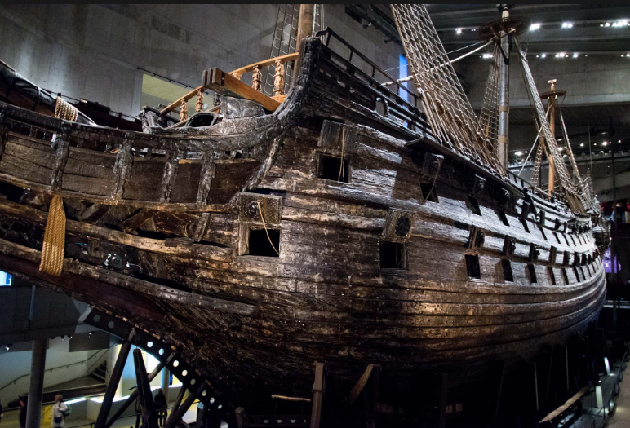
Another example of scope creep
The WASA – a true story of scope creep:
https://www.youtube.com/watch?v=kmJ59yyYza4&t=21s
Notes:
Image source: http://woondu.com/images/ships/wasa-swedish-war-ship-stockholm/wasa.jpg

